Slide 1

SPARK AIRWAYS - Wireframes
GOOD THINGS COME TO THOSE WHO FLY
Abhay Raj Singh
Anshuman Sahu
Bhavesh Saini
Nikhil Kharwal
Siddharth Sharma

Slide 2
Admin Wireframes
Wireframes for Admin in SPARK AIRWAYS

Slide 3
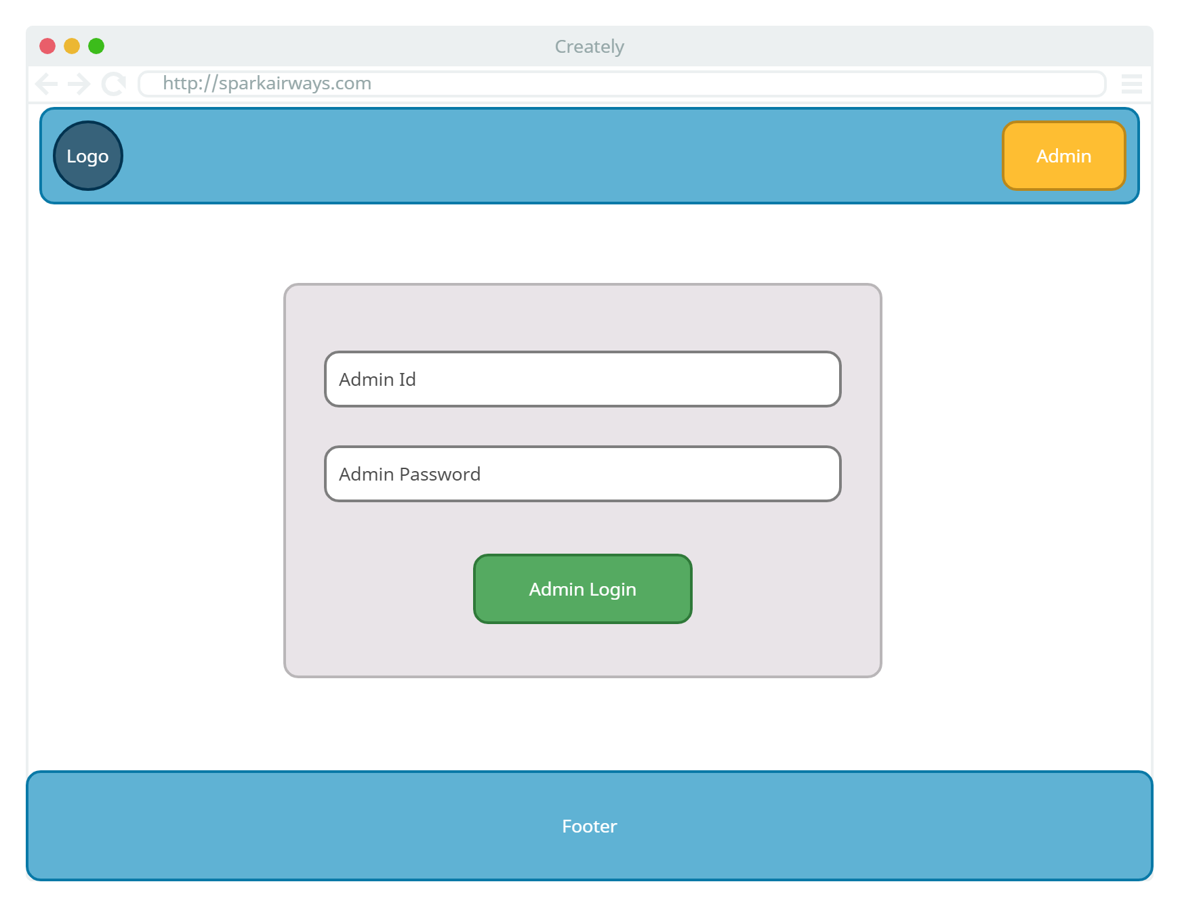

Slide 4
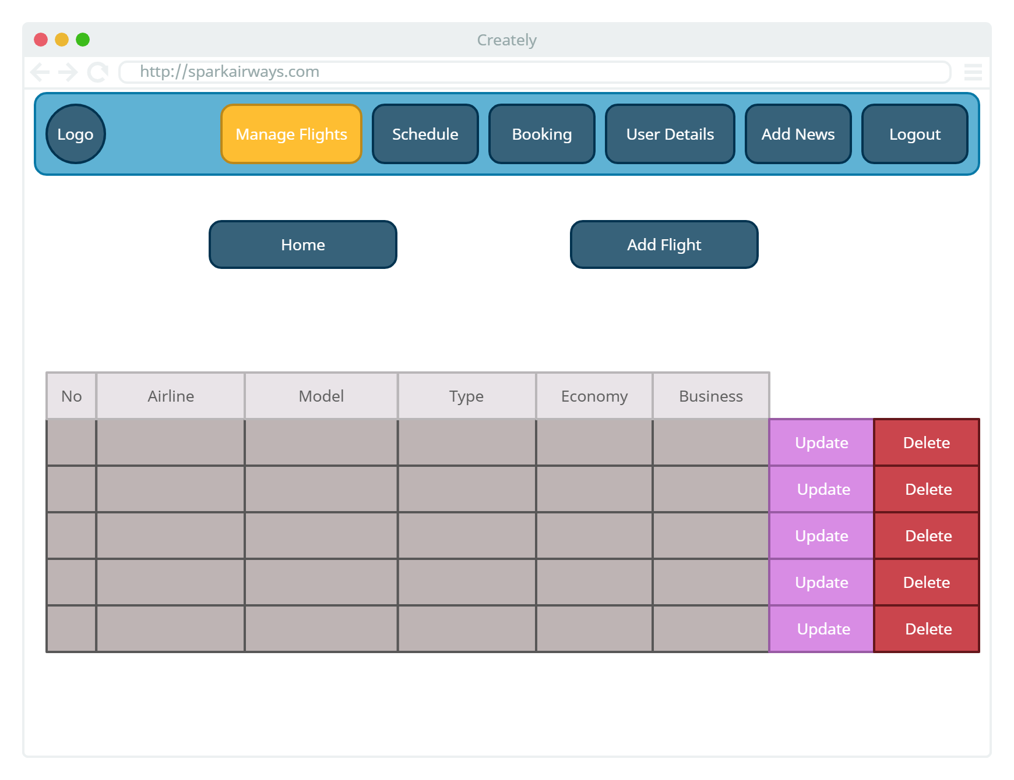

Slide 5
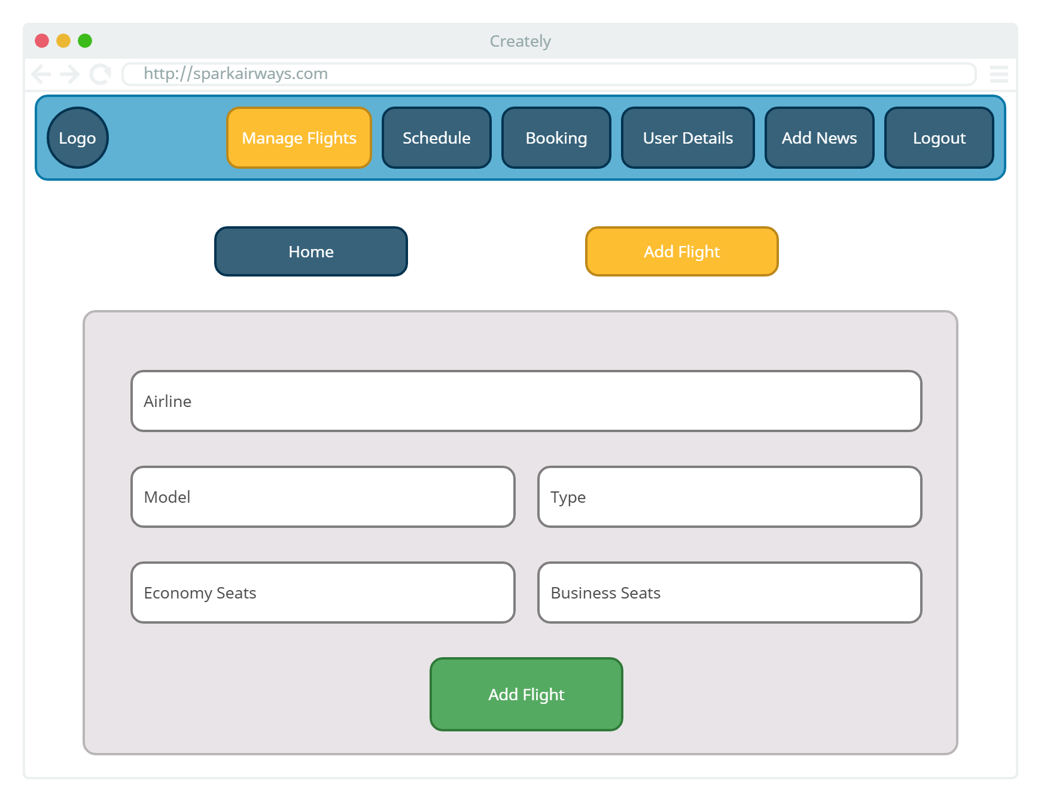

Slide 6
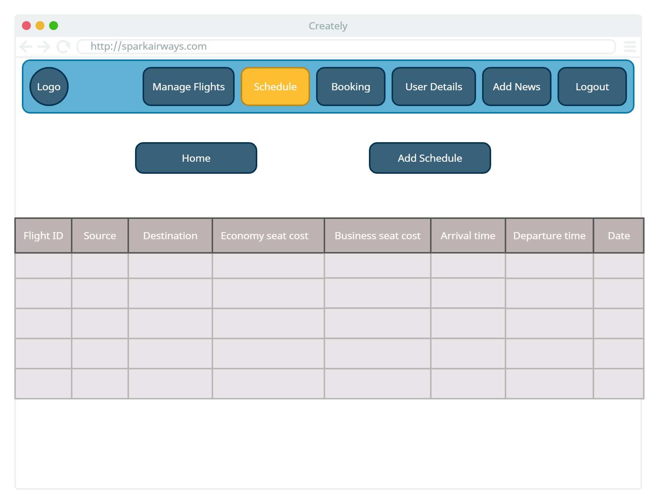

Slide 7
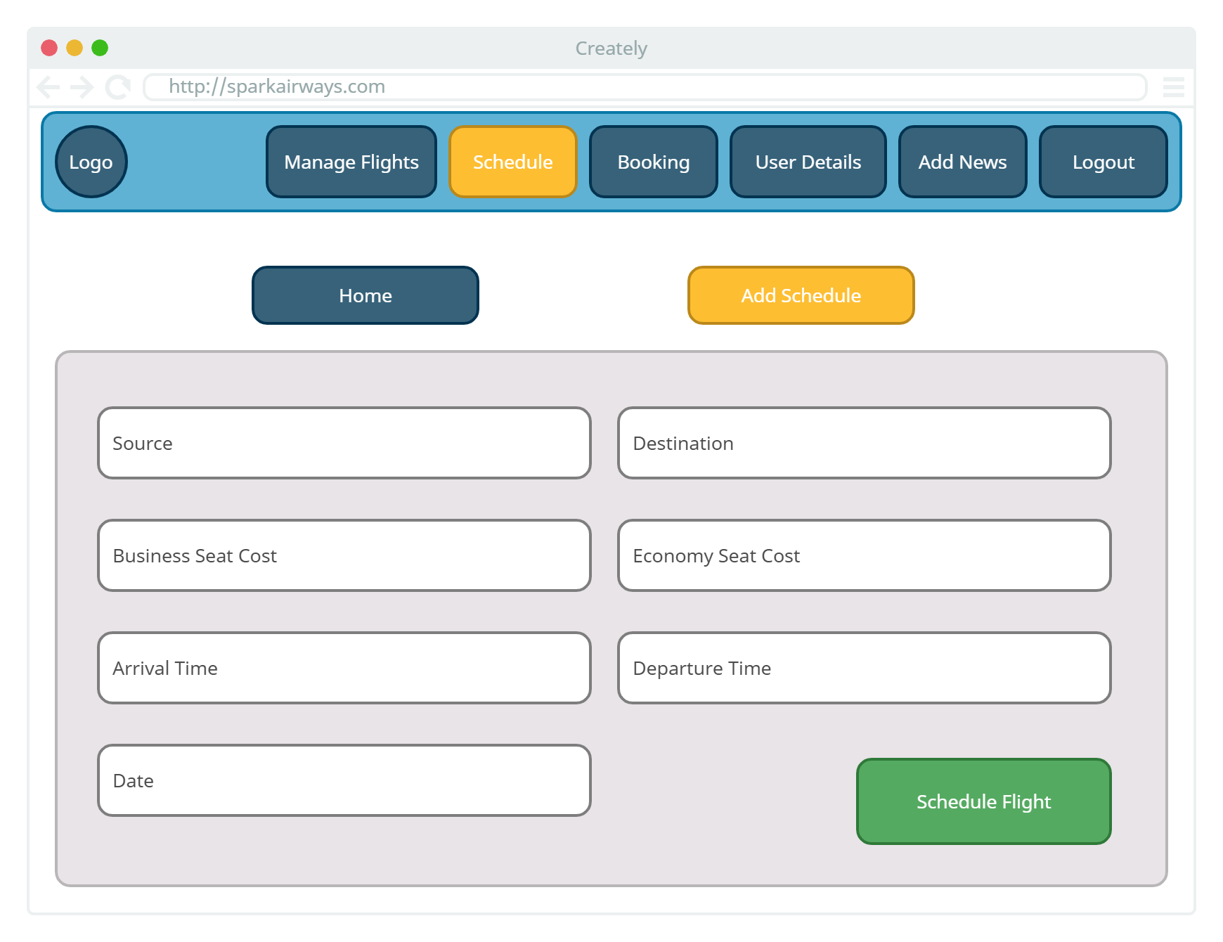

Slide 8
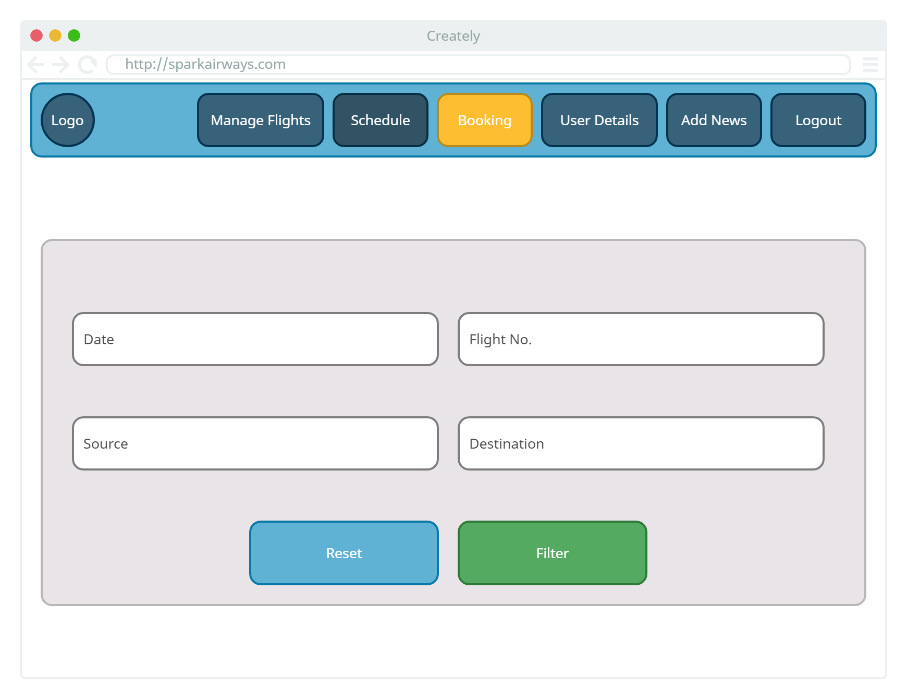

Slide 9
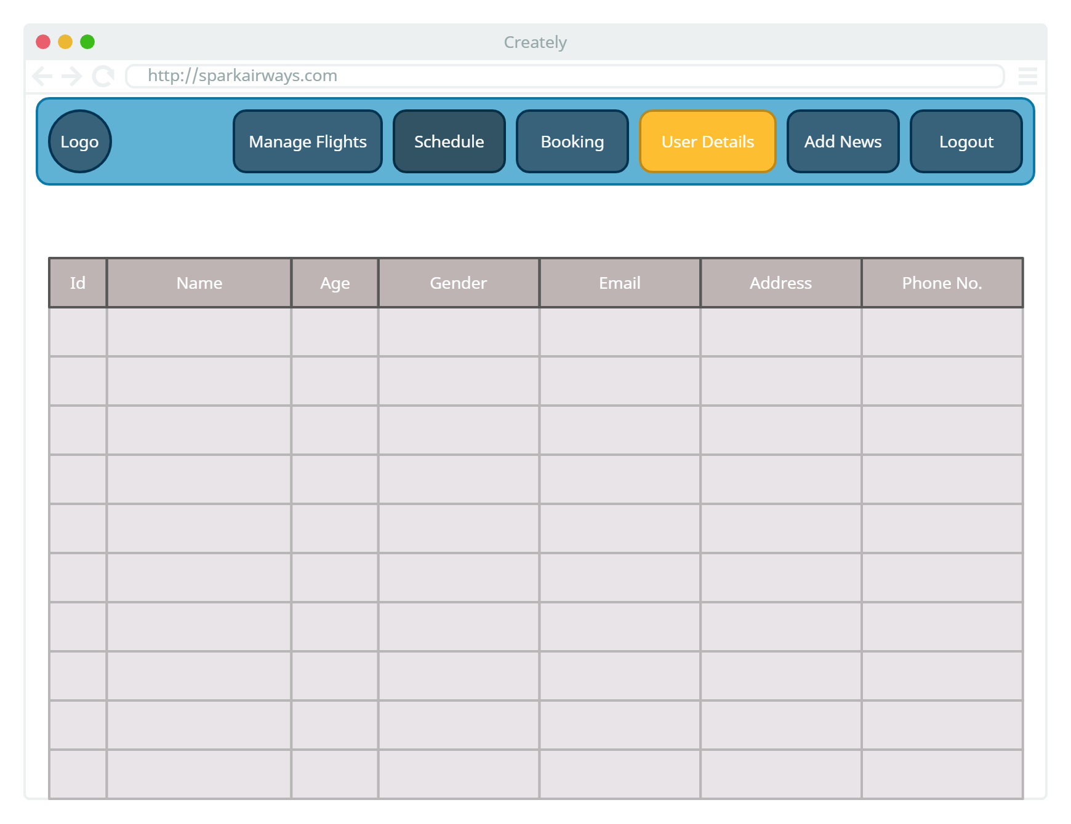

Slide 10
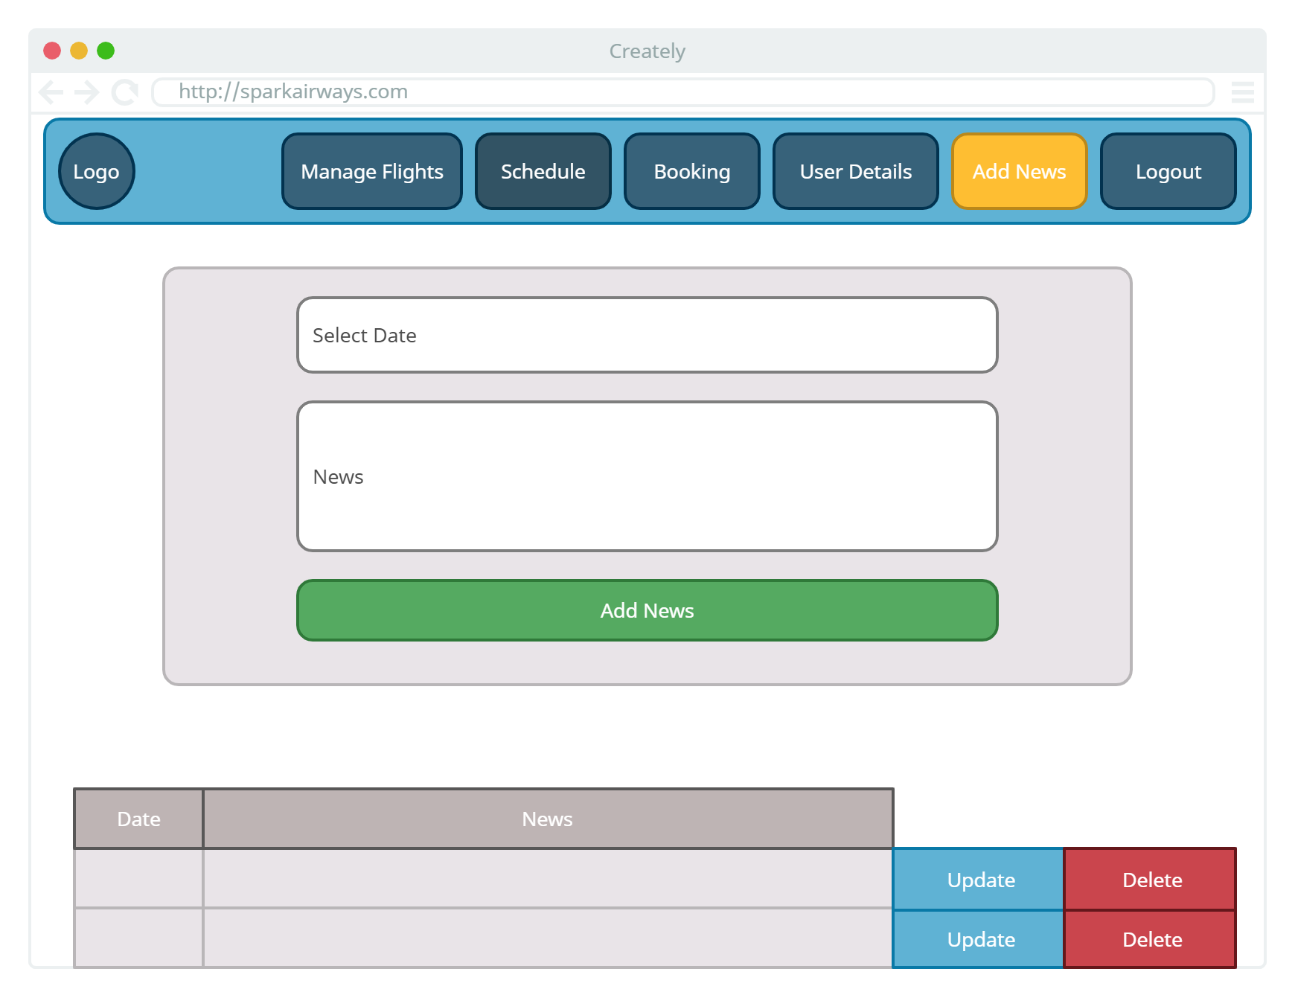

Slide 11
User Wireframes
Wireframes for User in SPARK AIRWAYS

Slide 12
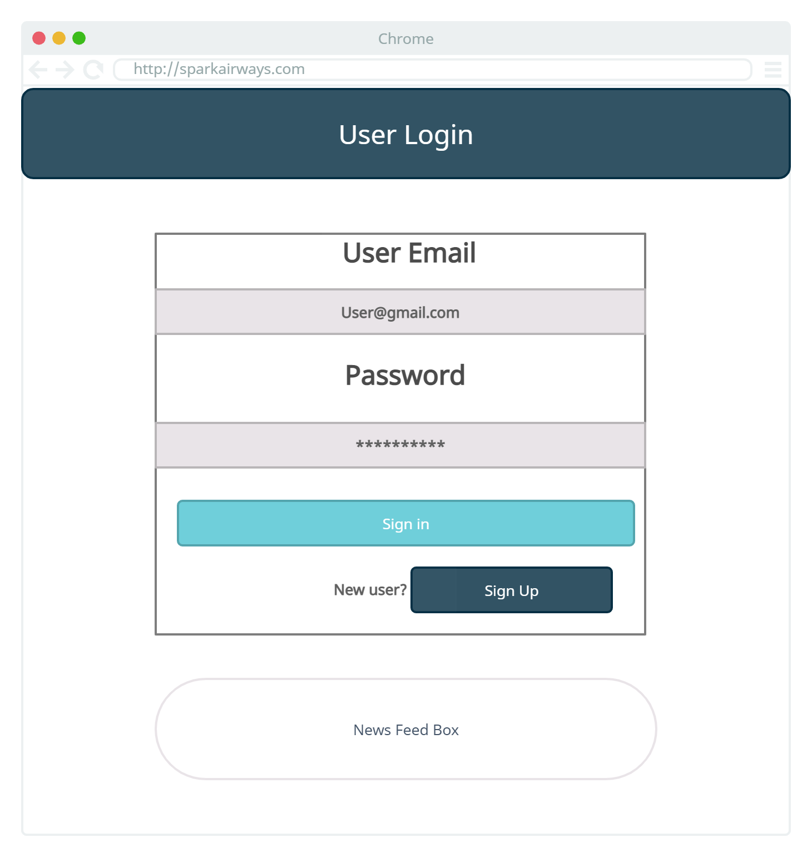

Slide 13
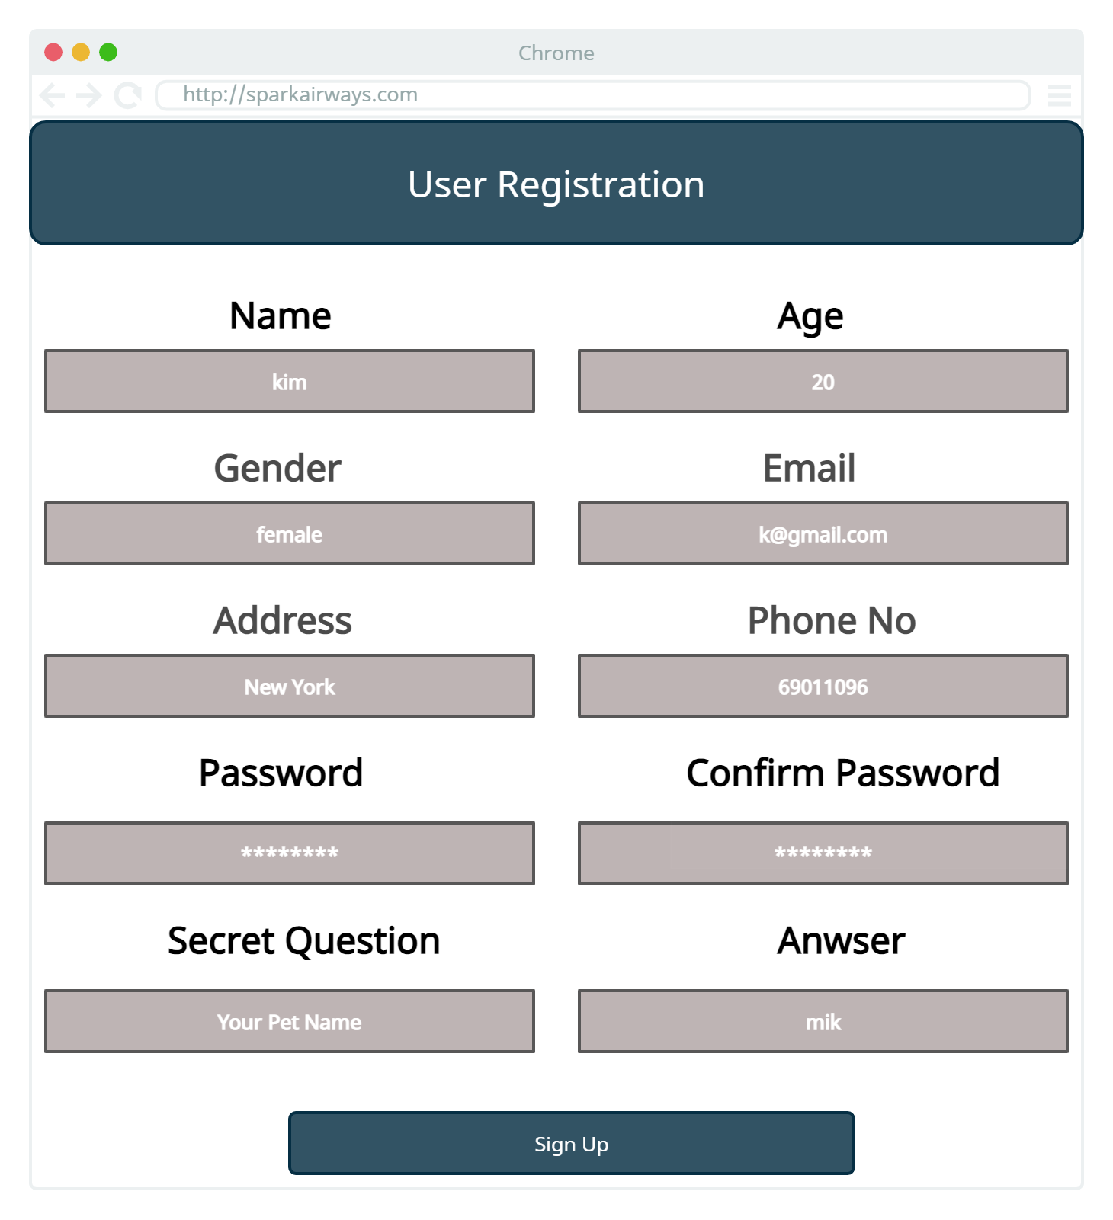

Slide 14


Slide 15
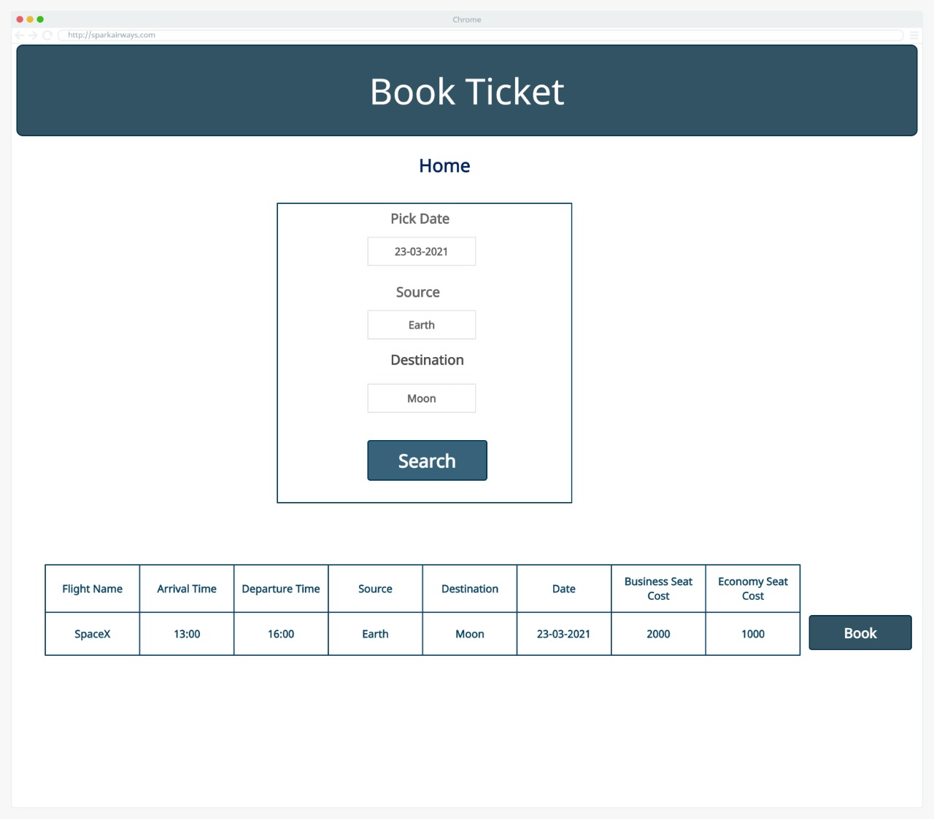

Slide 16
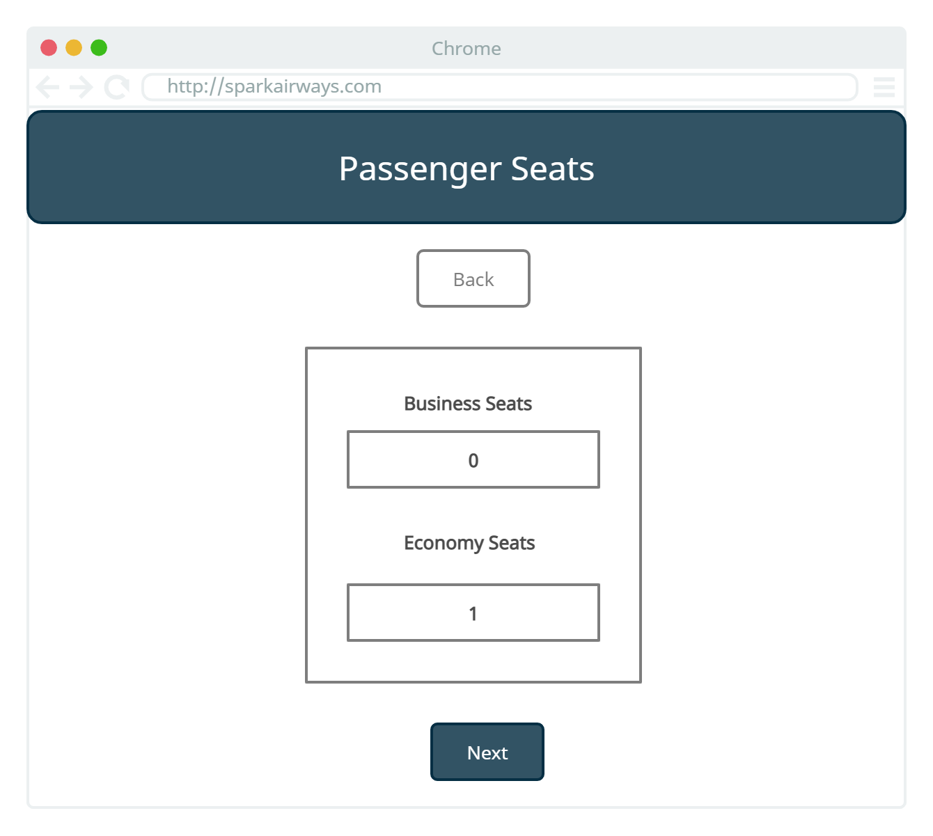

Slide 17
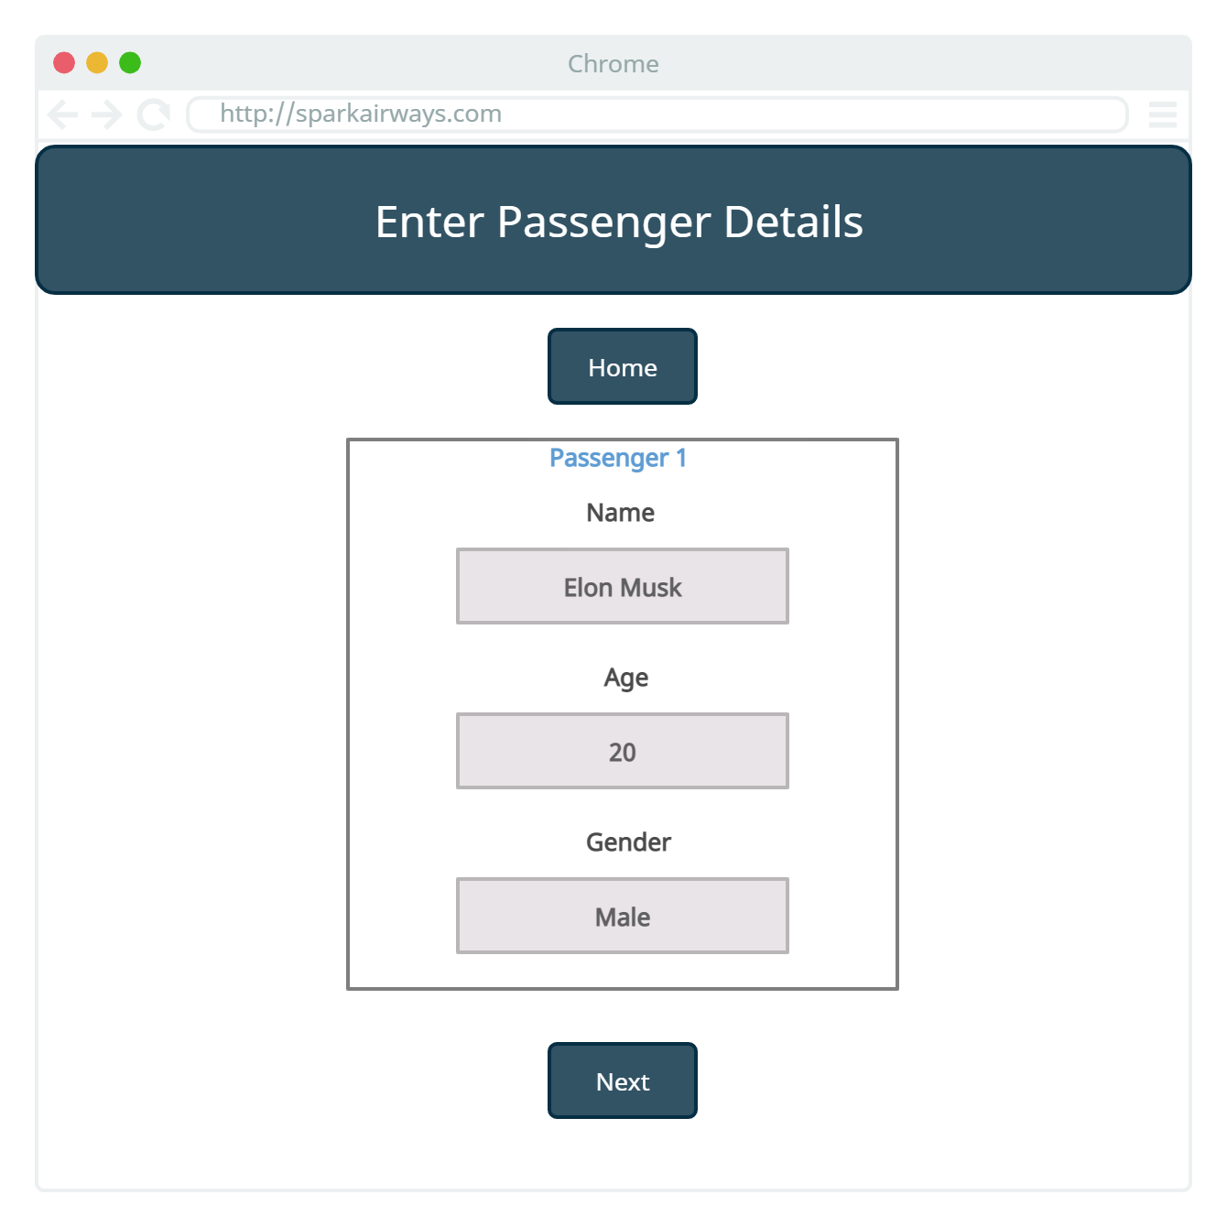

Slide 18
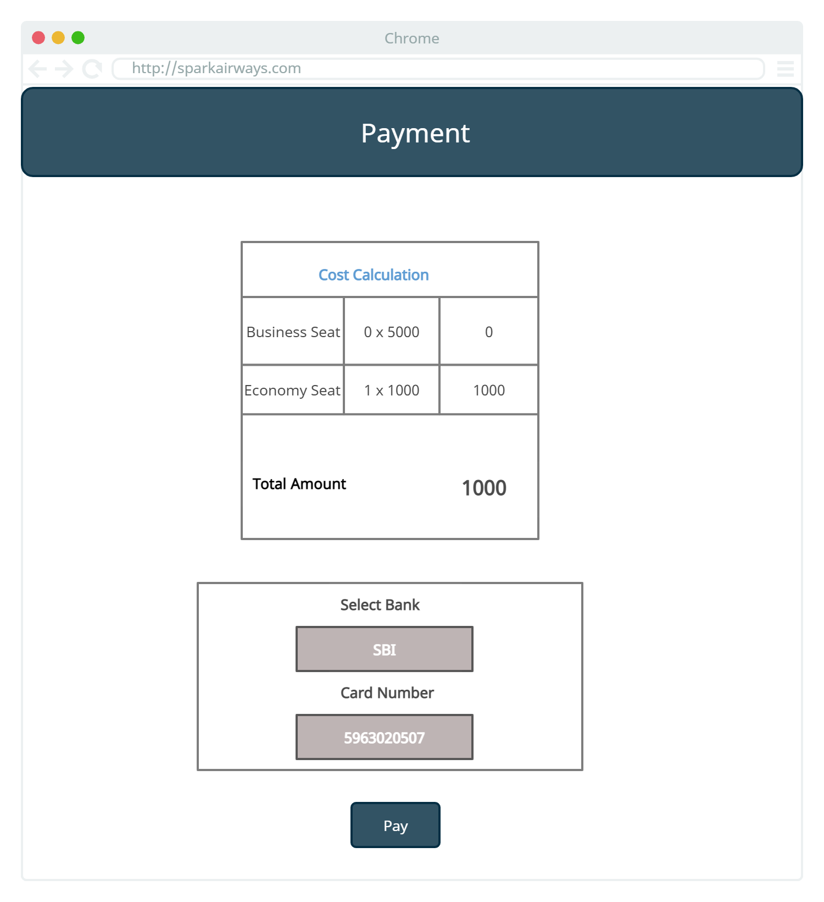

Slide 19
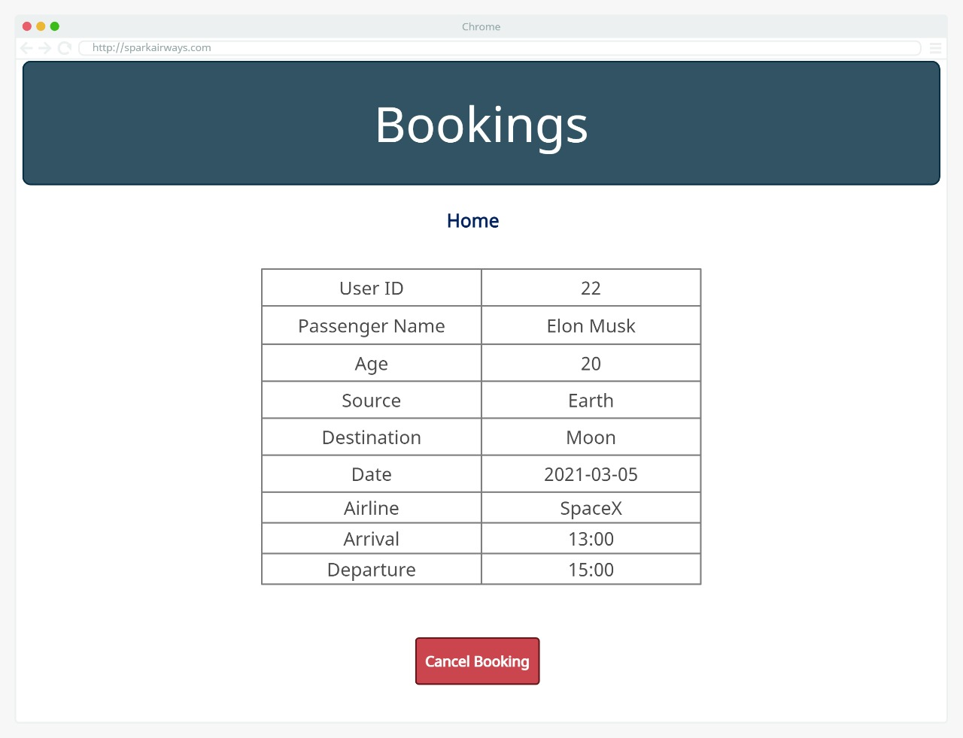

Slide 20
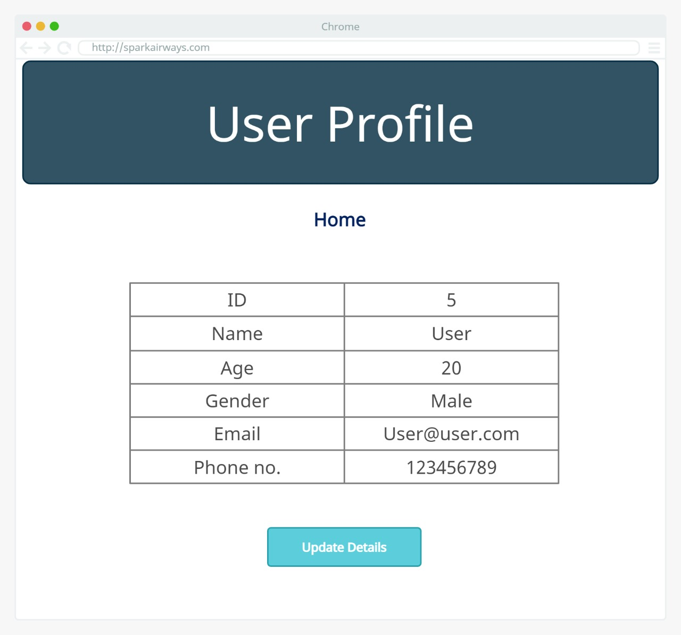

Slide 21
Thank You

